Slide 1
Tripsy
Project Title:
Presented By –
Sakshi Satish Deshmukh
Roll No - 23313
Guide Name –
Dr . B .H . Kaulwar

Slide 2
Introduction :
The Tour Planner project is an innovative web application designed to revolutionize the way travlers plan and manage their trips. At its core, the platform offers a comprehensive suite of tools and features aimed at simplifying the entire travel process, from destination exploration to itinerary creation and booking management .One of the key components of the Tour Planner project is its robust destination exploration feature. Users have access to a vast database of destinations, each accompanied by detailed information such as popular attractions, local culture, weather forecasts, and travel advisories. This wealth of information empowers users to make informed decisions when selecting their next travel destination.
Once users have chosen their destination, they can leverage the platform's itinerary creation tools to design personalized travel plans. From selecting specific attractions and activities to booking accommodations and transportation, users have full control over every aspect of their itinerary. The intuitive interface makes it easy for users to drag and drop elements to create the perfect travel schedule tailored to their preferences.Collaboration is another key aspect of the Tour Planner project. Users can invite friends, family, or fellow travelers to collaborate on trip planning, enabling seamless coordination and communication within groups. This feature is particularly useful for group trips or family vacations, where multiple individuals need to contribute to the planning process.

Slide 3
Existing System and Need for System :
The existing system is manual system. Needs to be converted into automated system.
Static information is provided for each package, including destinations and brief descriptions.
No interactive features for booking or customization.
No real-time or automated booking process.
No integrated system for real-time monitoring of profits and financial data related to bookings.
Less Security.
It was not reliable

Slide 4
Need for System :
It Implements an interactive and user-friendly interface for users to explore and book tour packages seamlessly.
Provide comprehensive details about each tour package, including destinations, activities, and adventures, to empower users in making informed decisions.
An automated system for managing bookings, including features for viewing, updating, and cancelling bookings.
Implement a system for automated financial tracking, enabling administrators to keep track of total profits made by bookings. Integrate a secure payment gateway for seamless and secure online transactions

Slide 5
Scope and Objectives of System :
The Objectives for this project are :-
The main objective is to create a Specialized Platform.
Provide users with an interactive and user-friendly platform that simplifies the exploration and booking of tour packages.
Implement a real-time booking system that enables users to customize their tours, make secure online payments, and receive instant confirmations.
Develop an efficient administrative control panel for managing tour packages, destinations, and bookings with ease.
Integrate a secure payment gateway to ensure the safety and confidentiality of online transactions for users.

Slide 6
Scope Of The System –
The scope of the Travel Explorer project is to develop a comprehensive and user-centric travel booking platform that facilitates seamless exploration, booking, and management of tour packages.
The system aims to enhance the user experience by providing interactive features, detailed tour information, and a secure online booking process.
The administrative section will empower administrators to efficiently manage tour packages, destinations, and bookings in real-time.
The project will also incorporate financial tracking and reporting features to provide insights into the profitability of the business.

Slide 7
System requirement specification (SRS) (Operating Environment Software and Hardware) :
Server side requirement
1.Hardware Requirements
Processor : intel core i5
RAM :8 GB
HDD : 80 GB
2. Software Requirements:
Operating System
Database : SQLite
Front End: HTML,CSS
Back End:Python

Slide 8
Client side requirement
1. Hardware Requirements:
Processor : intel
RAM :8 GB
HDD: 80GB
2. Software Requirements:
Operating System : Windows 11

Slide 9
List of Modules/ Functionalities with description:
1. User Module:
Tour Package Exploration:
• Allows users to browse through various tour packages.
• View details of each package, including destinations, activities, and pricing.
Booking Process: •
Enables users to select a tour package and specify the number of persons.
• Provides a secure and seamless payment gateway for completing transactions.
Tour Details and Adventures:
• Displays comprehensive information about each destination and the adventures included in the tour package.

Slide 10
List of Modules/ Functionalities with description:
2. Admin Module:
Tour Package Management:
• Allows the admin to add, update, or delete tour packages.
• Includes fields for destinations, activities, pricing, and other relevant details.
Destination and Adventure Management:
• Permits the admin to manage destinations and adventures independently.
• Add, update, or delete destinations and adventures associated with tour packages.
Booking Management:
• Provides an overview of all bookings made by users.
• Enables the admin to view, update, or cancel bookings as needed.

Slide 11
List of Modules/ Functionalities with description:
3. Authentication and Authorization:
• Ensures secure user authentication and authorization mechanisms.
• Differentiates between regular users and admin accounts.
• Restricts access to admin functionalities to authorized personnel.
4. Reporting Module:
• It will display Booking History Reports
• It will give Financial Summaries

Slide 12
Proposed System :
The front-end development tool is Django based which allows visualization to build the Tripsy Travel website. The back-end code is done with fully object-oriented. The Python is easy-to-use and efficient. The back-end database development tool used is SQLite Server. It is able to handle large amounts of data while maintaining data integrity and provides a number of senior management and data distribution functions. These two development tools are powerful, and a good interface for development

Slide 13
Feasibility Study :
Technical Feasibility : Technical feasibility assesses whether the proposed Bicycle Rental system can be developed using available technology and resources. In short, it confirms that building the system is technically possible within constraints like budget, expertise, and existing infrastructure.
Economic Feasibility : Economic feasibility evaluates whether developing the Bicycle Rental system is financially viable. In short, it examines if the benefits, such as increased efficiency and revenue, outweigh the costs, including development, maintenance, and operational expenses.
Operational Feasibility : Operational feasibility assesses whether implementing the Bicycle Rental System is practical and sustainable. It considers factors like user acceptance, ease of use, and the impact on existing operations. In short, it examines if the system can be effectively integrated into the organization's workflow and if users can readily adapt to it.

Slide 14
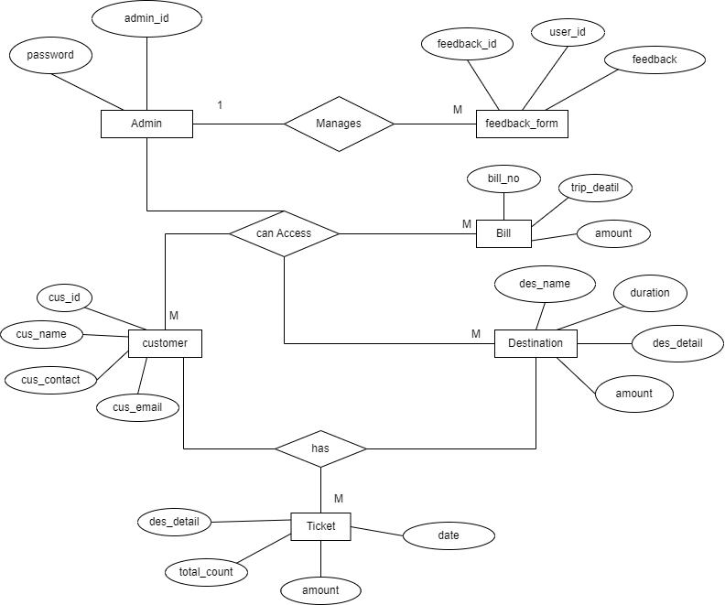
UML Diagrams : ERD Diagram

Slide 15
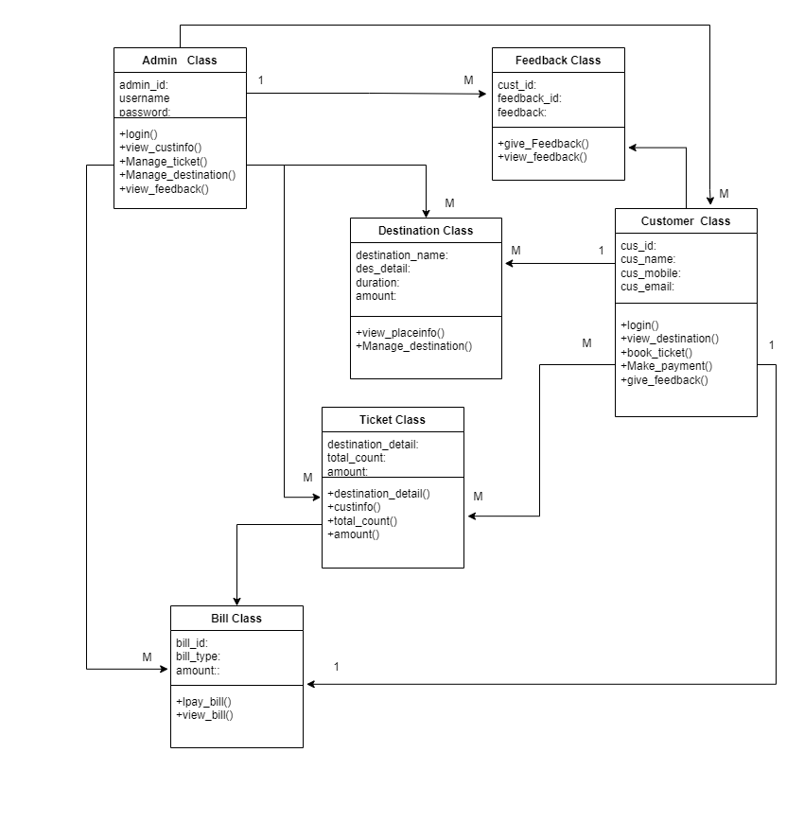
Class Diagram:

Slide 16
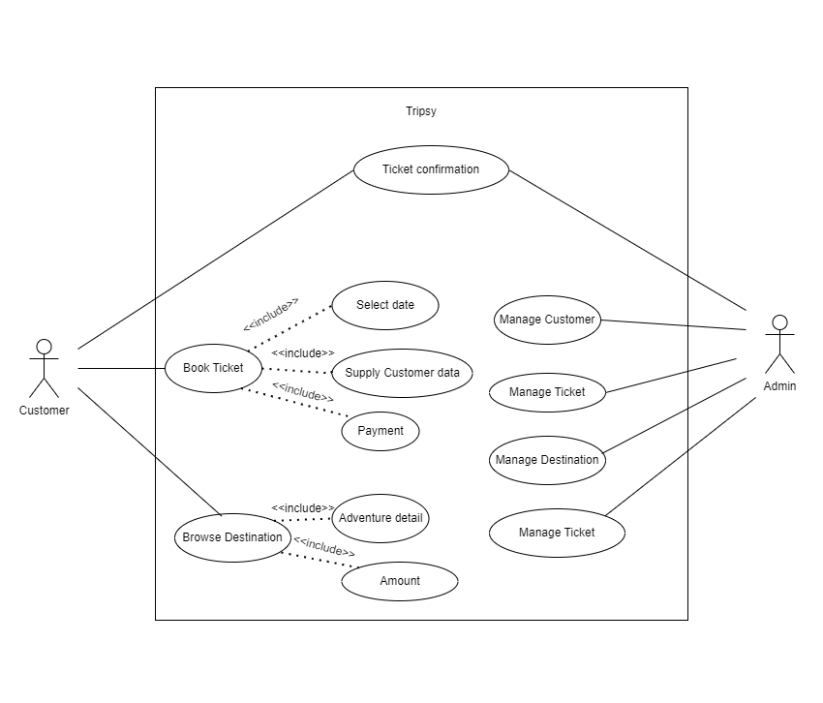
Use Case Diagram:

Slide 17
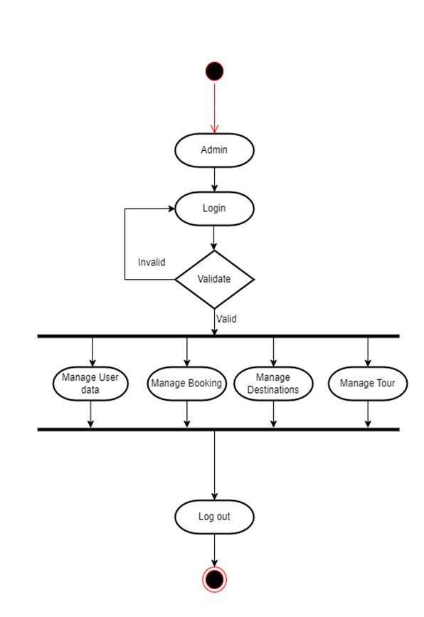
Activity Diagram: (Admin)

Slide 18
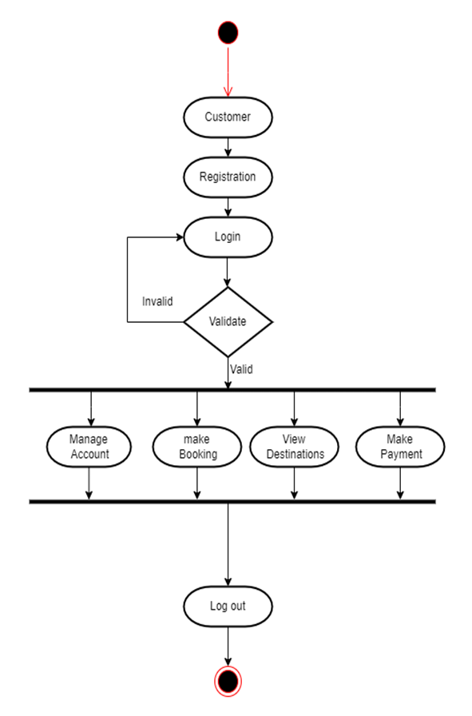
Activity Diagram: (User)

Slide 19
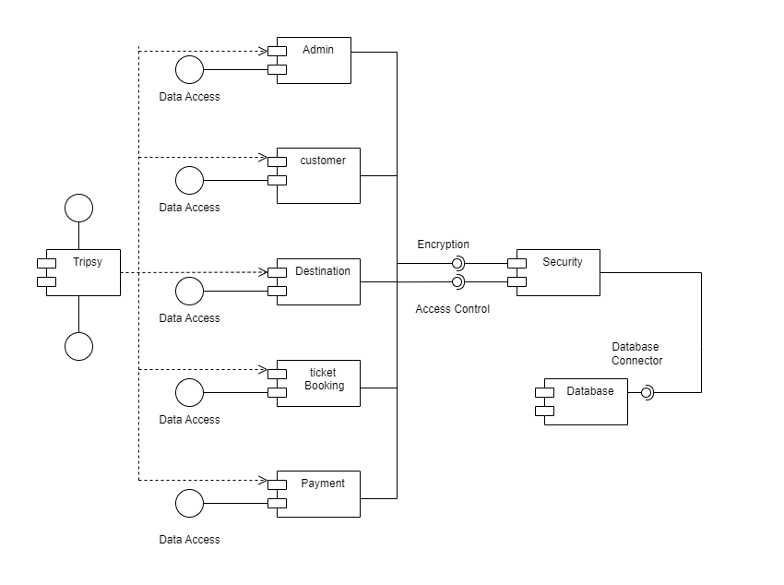
Component Diagram:

Slide 20
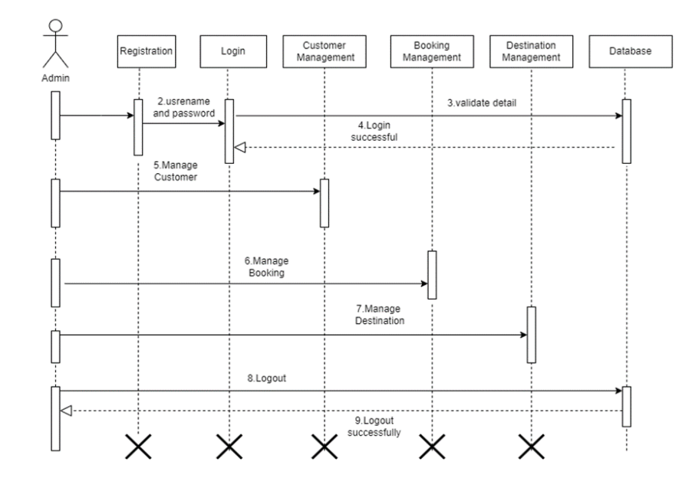
Sequence Diagram: (Admin)

Slide 21
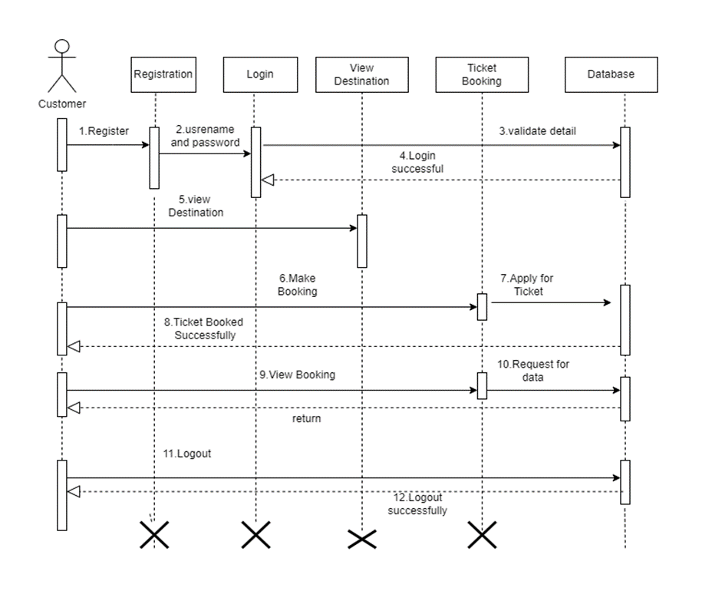
Sequence Diagram: (User)

Slide 22
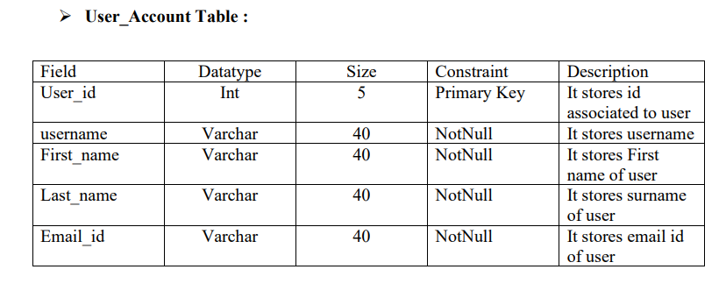
Table Data:

Slide 23
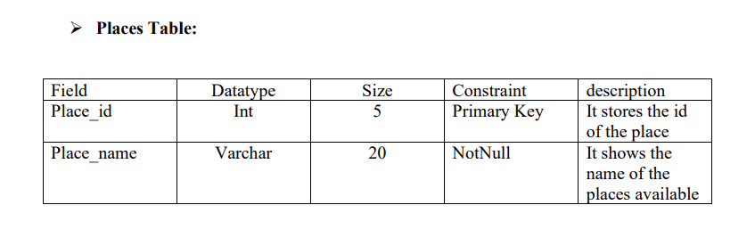

Slide 24
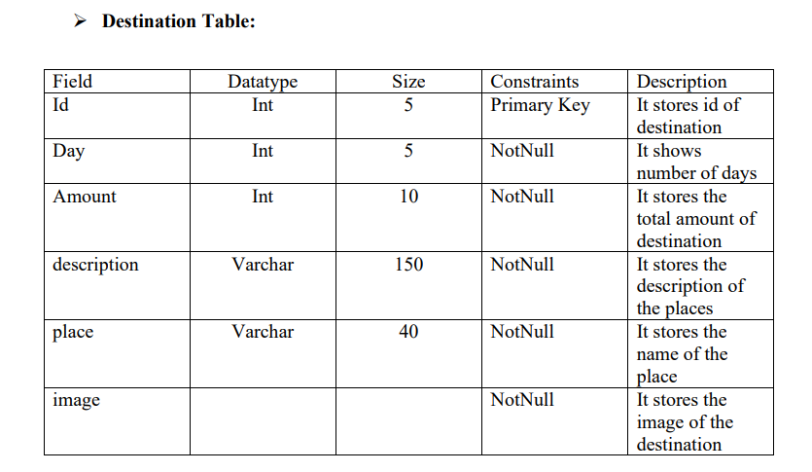

Slide 25
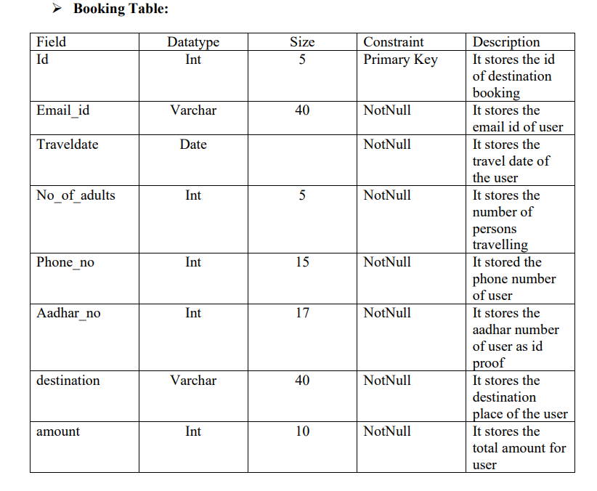

Slide 26
Output Slides :

Slide 27
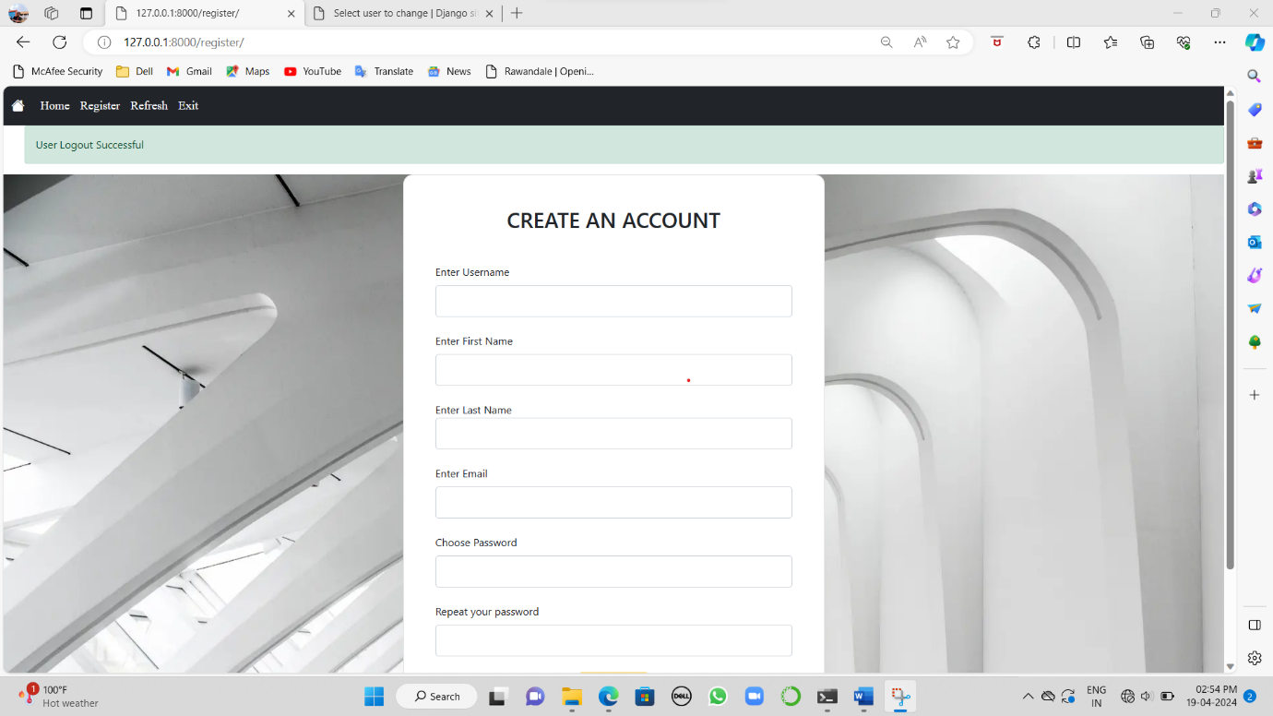
Registration:

Slide 28
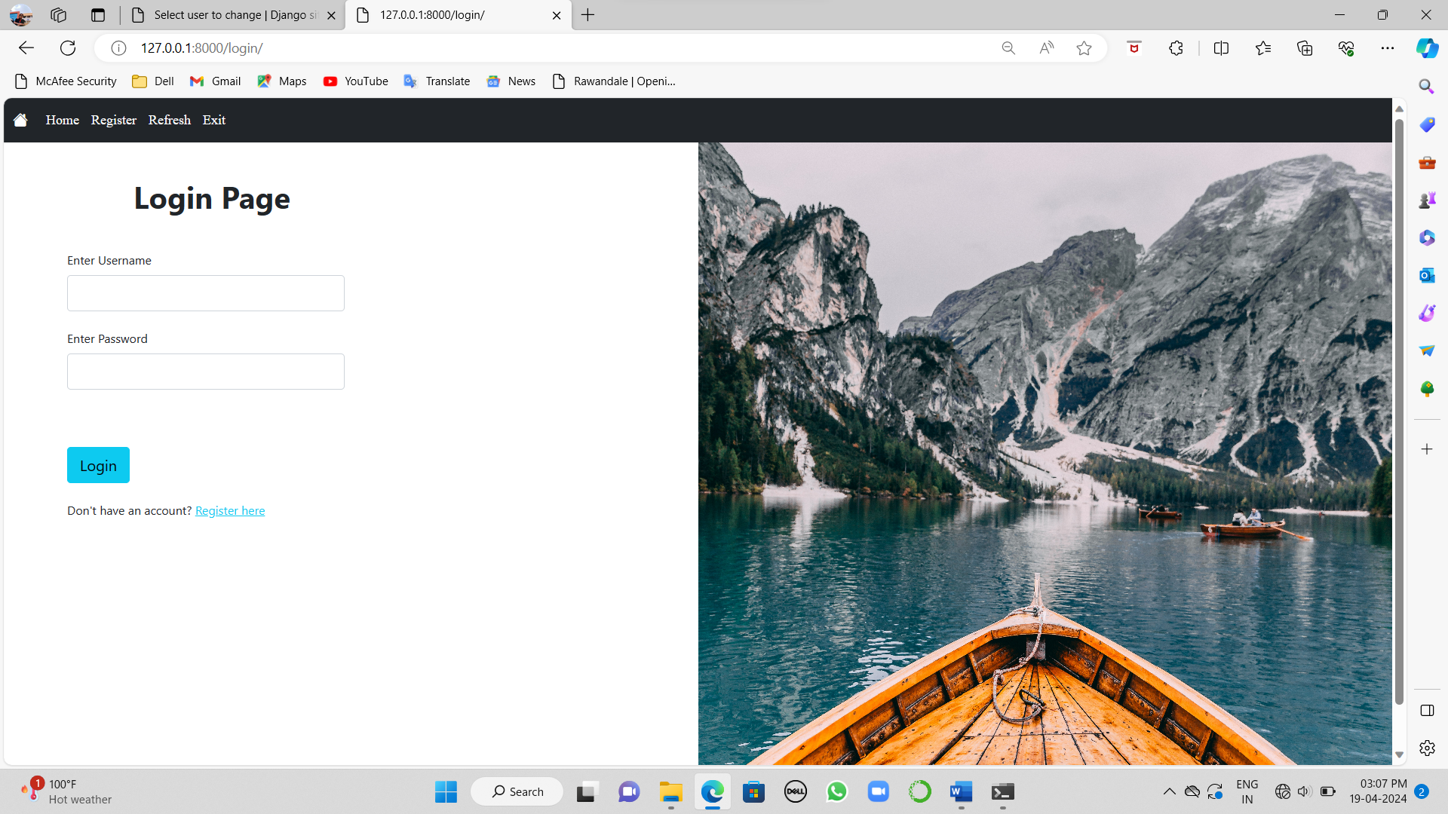
Login:

Slide 29
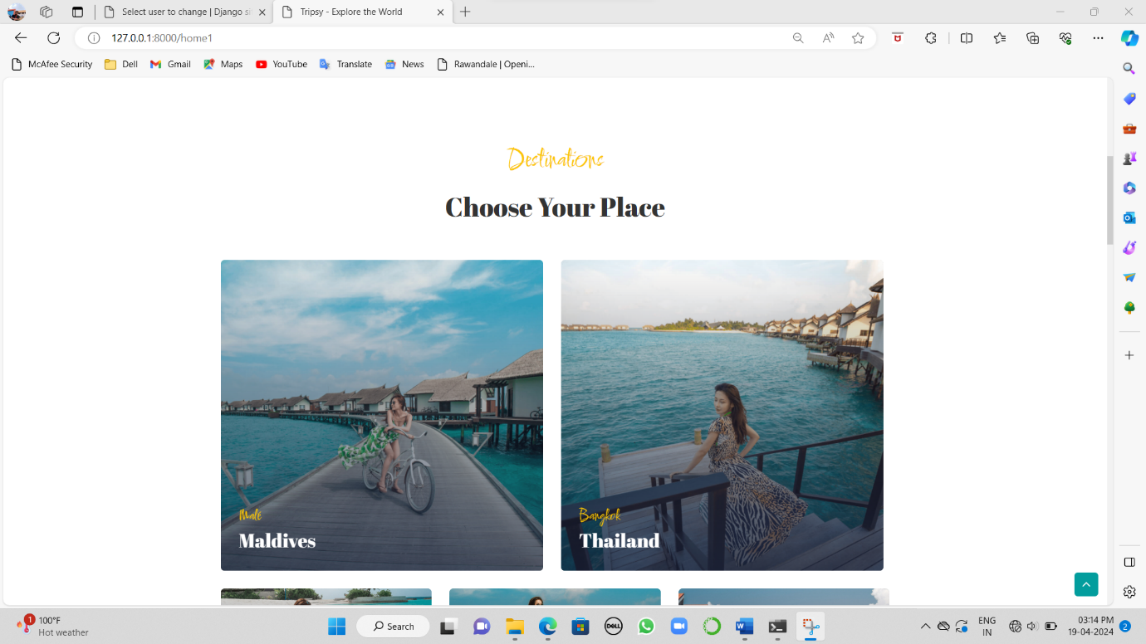
Package Booking Screen:

Slide 30
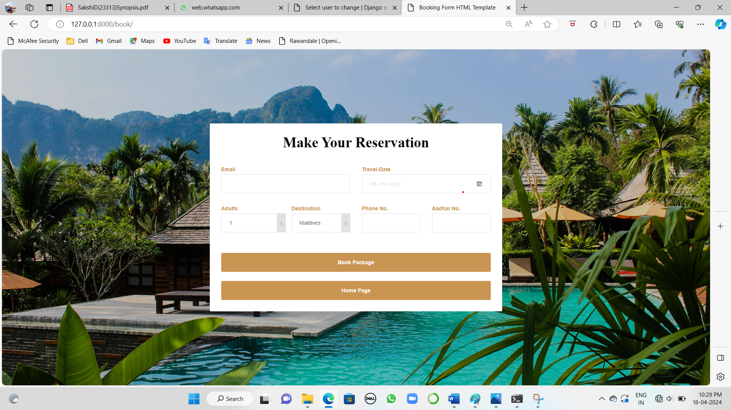
Ticket Reservation Screen :

Slide 31
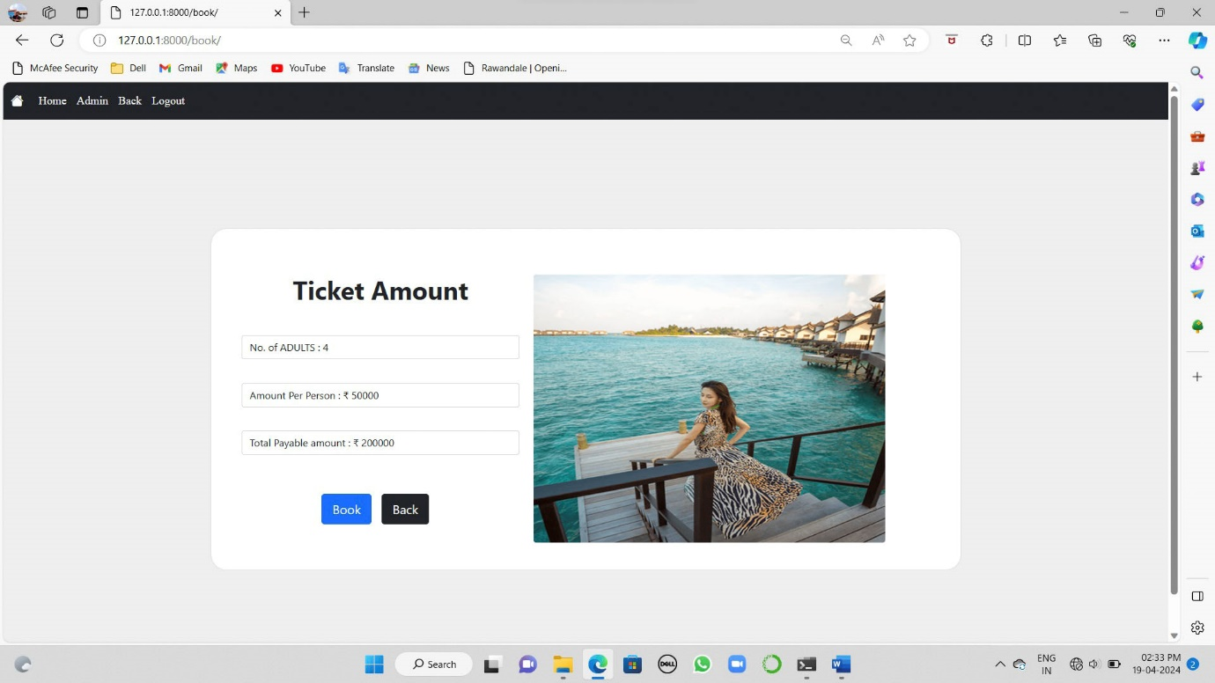
Confirm Ticket Screen:

Slide 32
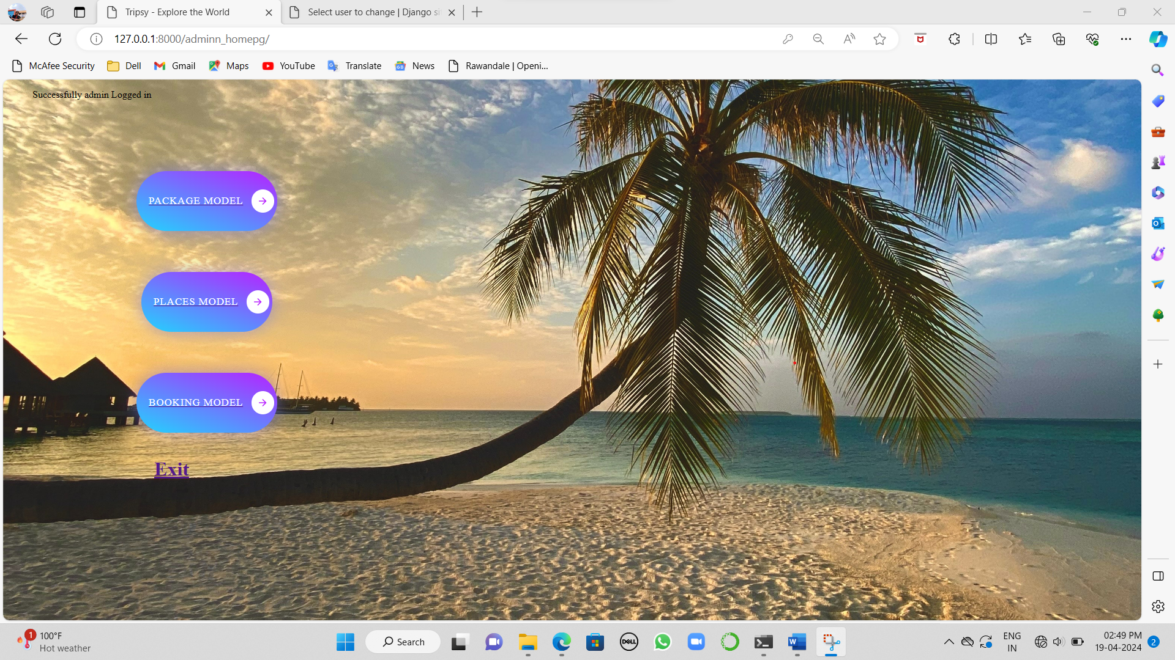
Admin side Screen :

Slide 33
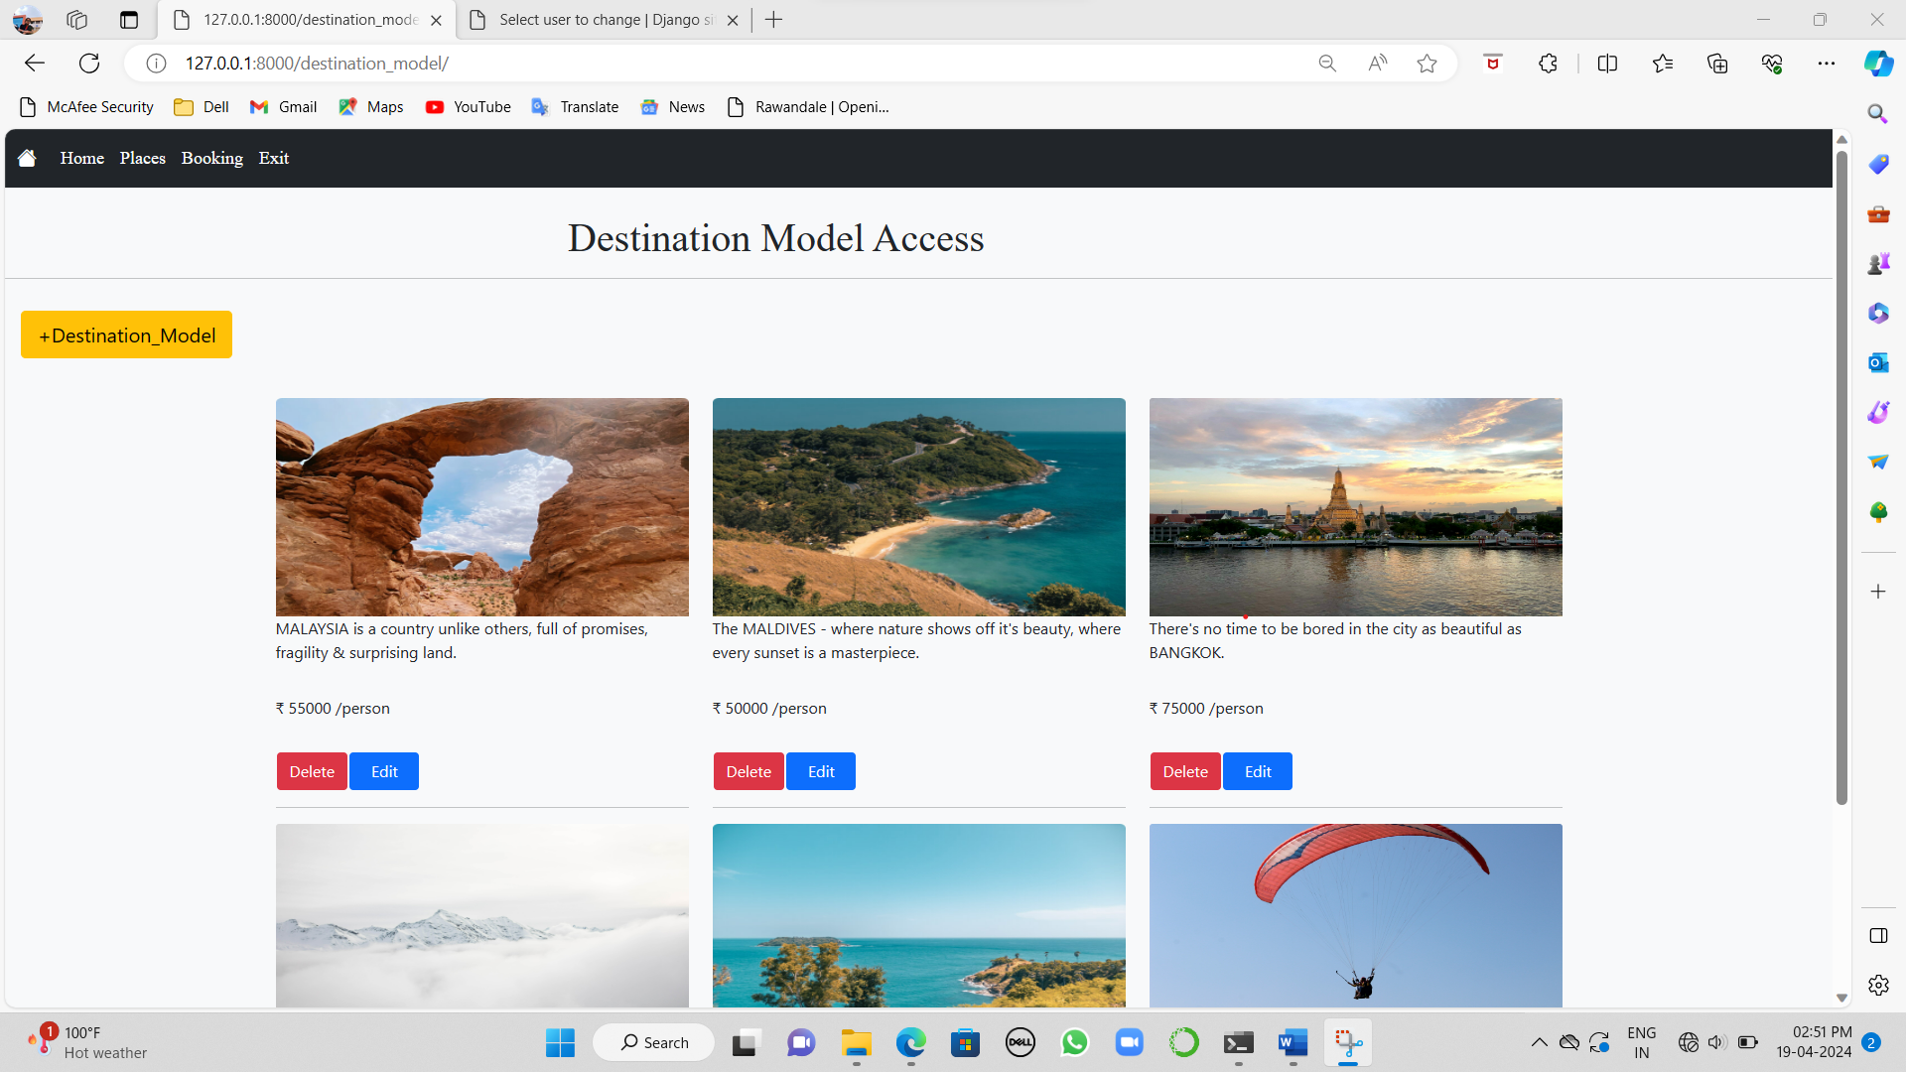
Destination Model Screen:

Slide 34
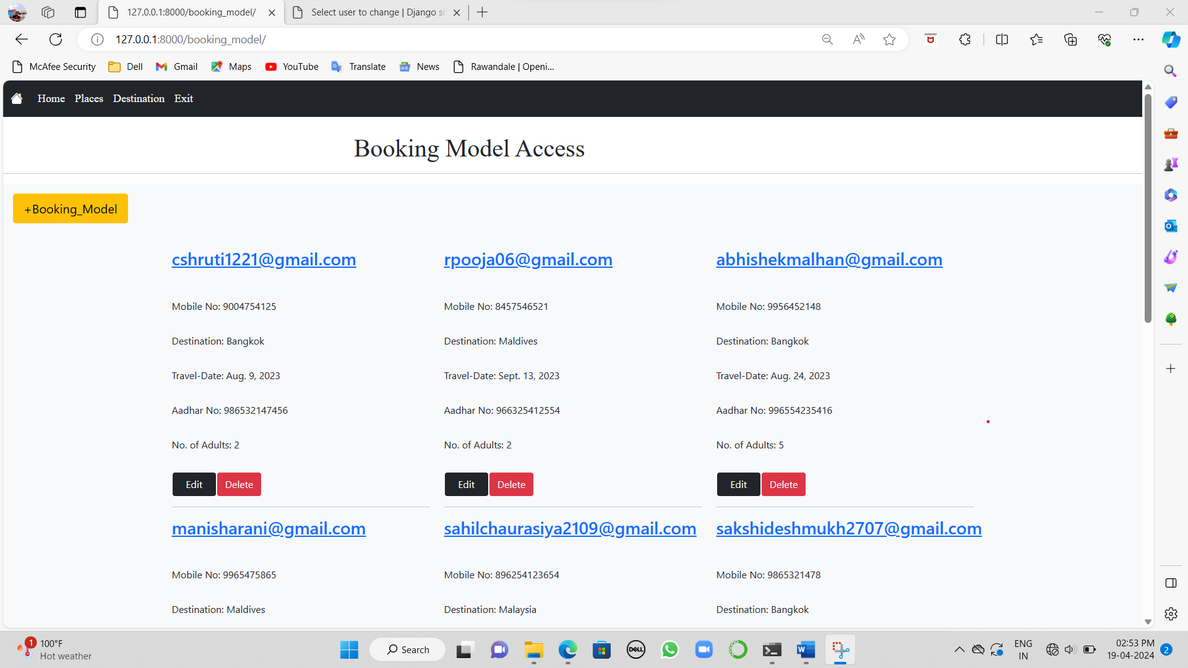
Booking Model Screen :

Slide 35
Thank You !

